Slide 1
Exercise 1
Practice of C Programming on real world / technical applications using statements, expressions, decision making constructs and iterative and branching constructs.

Slide 2
Decision Control Statements
C supports decision control statements that can alter the flow of a sequence of instructions.
These statements help to jump from one part of the program to another depending on whether a particular condition is satisfied or not.
These decision control statements include:
(a) if statement,
(b) if–else statement,
(c) if–else–if statement, and
(d) switch–case statement.

Slide 3
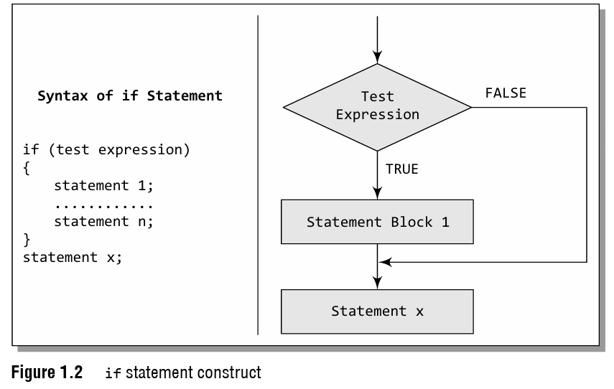
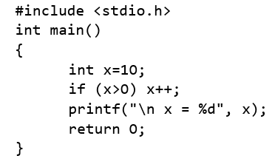
if Statement
if statement is the simplest decision control statement that is frequently used in decision making.
The general form of a simple if statement is shown in Fig. 1.2.

Slide 4
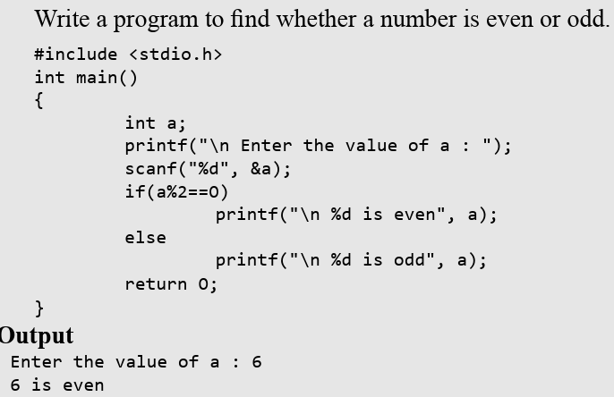
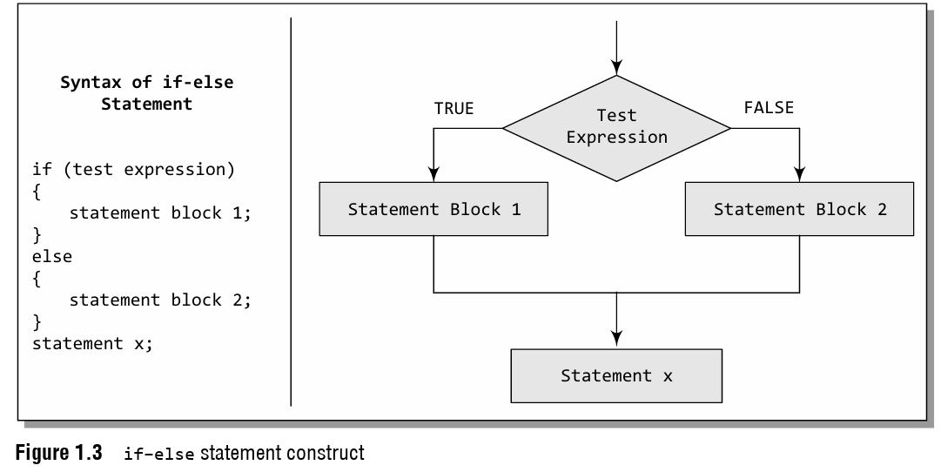
if–else Statement
What if you want a separate set of statements to be executed if the expression returns a false value?
In such cases, we can use an if–else statement rather than using a simple if statement.
The general form of simple if–else statement is shown in Fig. 1.3.

Slide 5
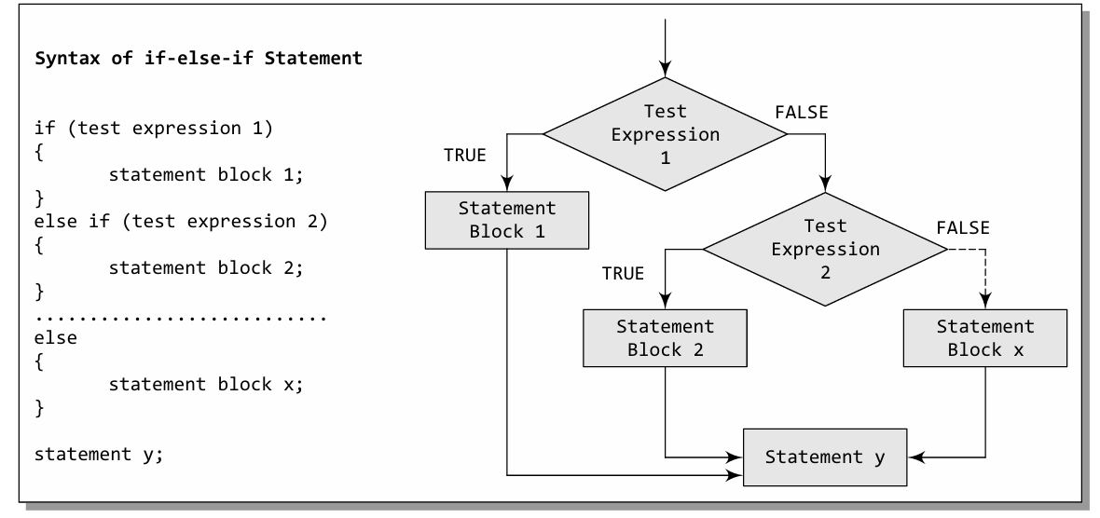
if–else–if Statement

Slide 6
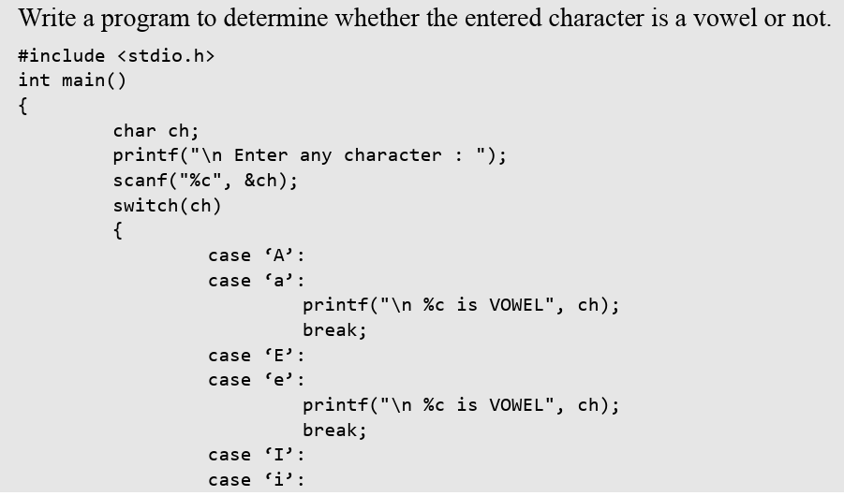
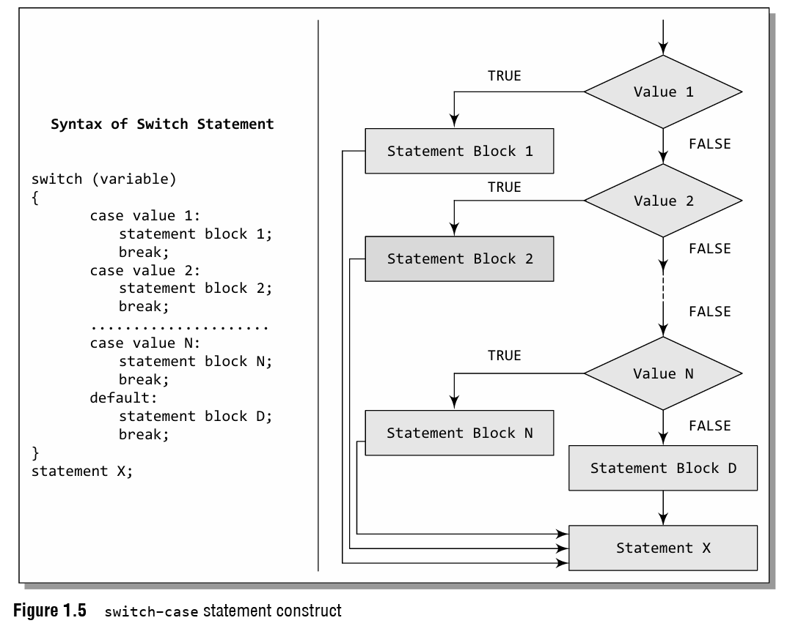
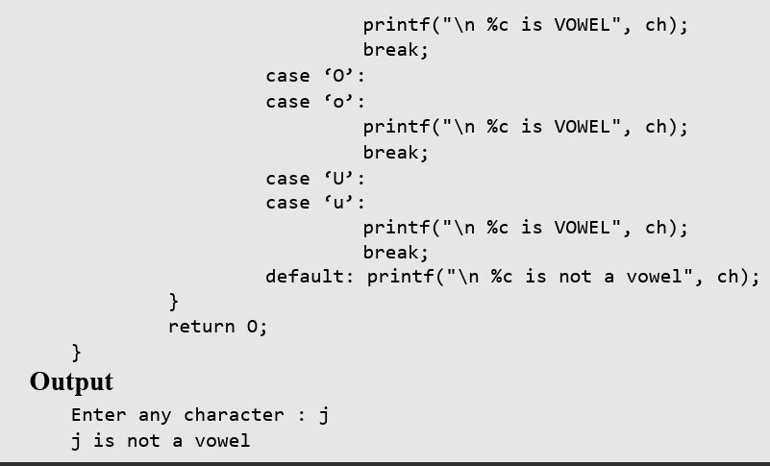
switch–case Statement
A switch-case statement is a multi-way decision statement that is a simplified version of an if else–if block.
The general form of a switch statement is shown in Fig. 1.5.

Slide 7
Iterative Statements
Iterative statements are used to repeat the execution of a sequence of statements until the specified expression becomes false.
C supports three types of iterative statements also known as looping statements.
They are
while loop
do–while loop
for loop

Slide 8
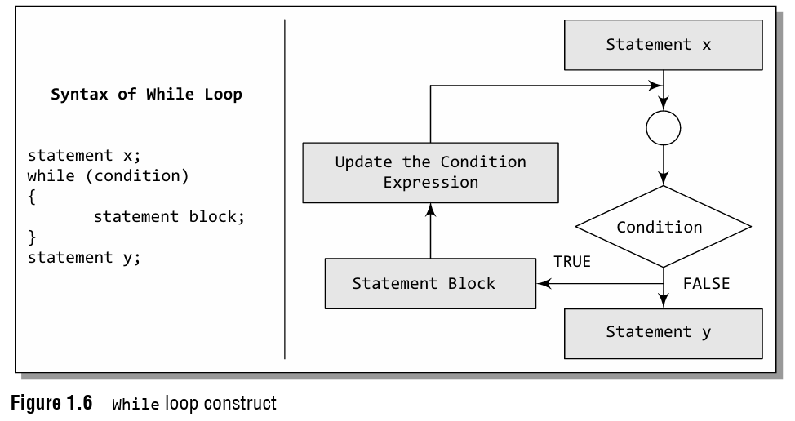
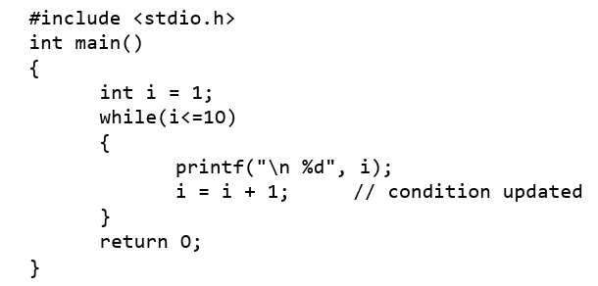
while Loop
The while loop provides a mechanism to repeat one or more statements while a particular condition is true.
Figure 1.6 shows the syntax and general form of a while loop.

Slide 9
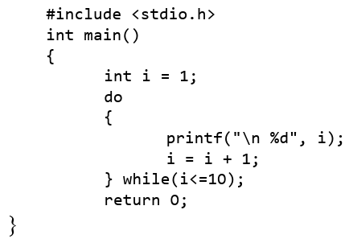
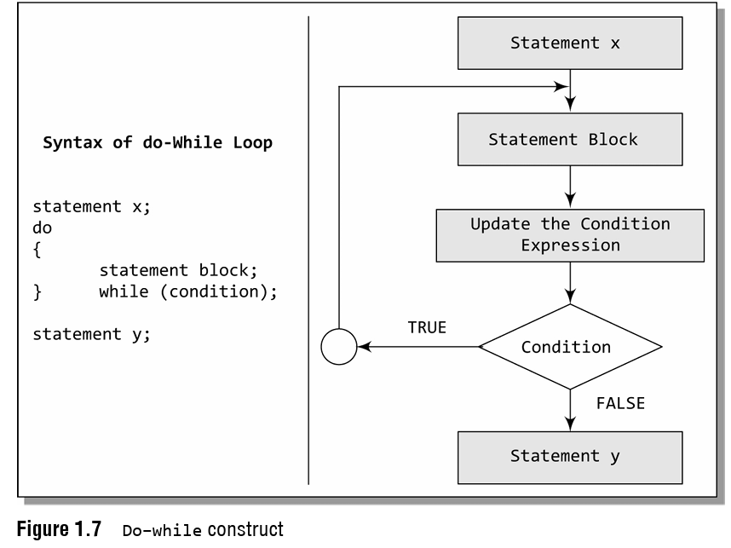
do–while Loop
The do–while loop is similar to the while loop.
The only difference is that in a do–while loop, the test condition is tested at the end of the loop.
As the test condition is evaluated at the end, this means that the body of the loop gets executed at least one time (even if the condition is false).
Figure 1.7 shows the syntax and the general form of a do–while loop.

Slide 10
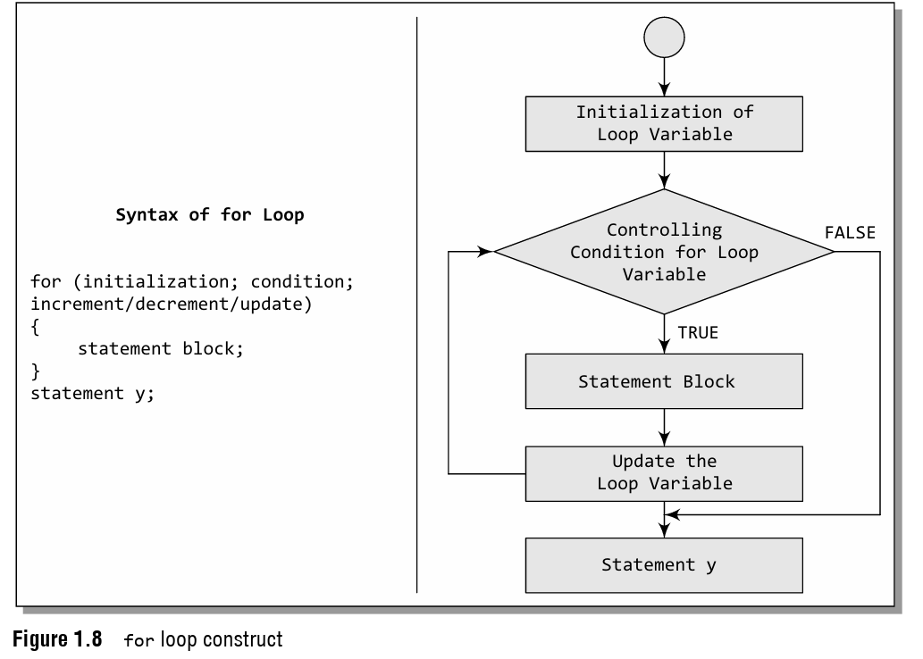
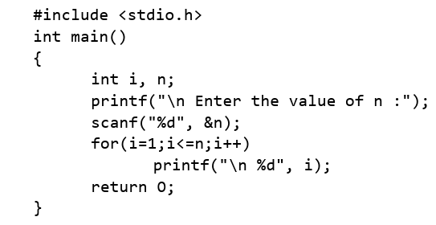
for Loop
Like the while and do–while loops, the for loop provides a mechanism to repeat a task till a particular condition is true.
The syntax and general form of a for loop is given in Fig. 1.8.

Slide 11
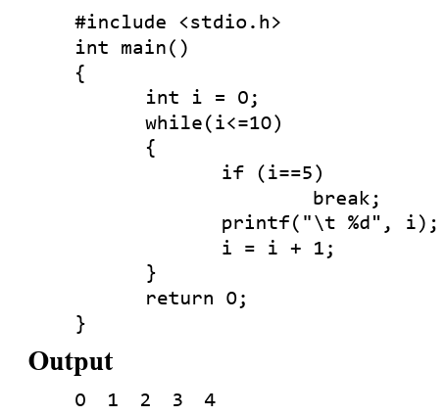
break Statement
In C, the break statement is used to terminate the execution of the nearest enclosing loop in which it appears.

Slide 12
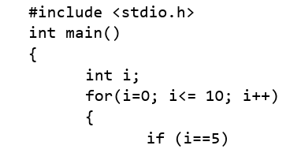
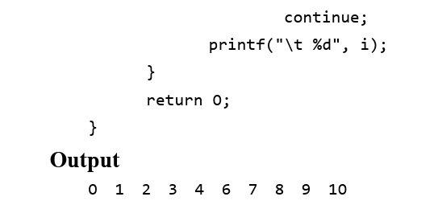
continue Statement
Like the break statement, the continue statement can only appear in the body of a loop.
When the compiler encounters a continue statement, then the rest of the statements in the loop are skipped and the control is unconditionally transferred to the loop-continuation portion of the nearest enclosing loop.

